Slide 1
FUNCTIONAL DIVERSITY INDICES

Slide 2
Functional Trait
Functional traits are morphological, biochemical, physiological, structural, phenological, or behavioral characteristics that are expressed in phenotypes of individual organisms and are considered relevant to the response of such organisms to the environment and/or their effects on ecosystem properties.
(Violle et al. 2007).
"Any features measurable at the individual level, without reference to the environment or any other level of organization, and which impact fitness indirectly via their effects on growth, reproduction and survival” (Violle et al., 2007).

Slide 3
Functional Diversity
The functional diversity of a community is a facet of biodiversity quantifying the value and range of organismal traits that influence their performance and thus ecosystem functioning
(Diaz and Cabido 2001).

Slide 4
There is an increasing body of literature demonstrating that functional diversity, rather than species diversity, enhances ecosystem functions such as productivity, resilience to perturbations or invasion and regulation in the flux of matter.

Slide 5
Criteria for for functional diversity index
Various indices have been proposed to measure the functional diversity of a community, but there is still no consensus on which are most suitable.
Indeed, none of the existing indices meets all the criteria required for general use. The main criteria are:
They must be designed to deal with several traits.
They must take into account abundances.
and measure all the facet of functional diversity.
Three indices to quantify each facet of functional diversity for a community with species distributed in a multidimensional functional space.

Slide 6
Three complimentary Indices
Functional Richness : Volume of the functional space occupied by the community.
Functional Evenness : Regularity of the distribution of abundance.
Functional Divergence : Divergence in the distribution of abundance.
None of the indices meets all the criteria required for a functional diversity index, but instead the set of three complementary indices meets these criteria.
The three functional diversity indices are independent of each other. Overall, study suggests that decomposition of functional diversity into its three primary components provides a meaningful framework for its quantification and for the classification of existing functional diversity indices.

Slide 7
Multidimensional Functional Diversity Indices
From a geometrical point of view, a species’ functional niche may be described by its position in a functional-trait space.
Assuming that we have T functional-trait values for each species of a given community, the functional-niche space is then the T dimensional space defined by the T axes, each one corresponding to a trait.
The community studied is composed of S species. Any species i has T traits of standardized values (xi1, xi2, . . . , xiT) which are conceived as coordinates in the functional trait space.
Relative abundances of species are noted (w1, w 2, . . .wS), with Σwi =1, i to S.

Slide 8
Functional Richness
Functional richness represents the amount of functional space filled by the community.
Cornwell et al. (2006) proposed the convex hull volume as a measure of the functional space occupied by a community.
The convex hull is actually the minimum convex hull which includes all the species considered, the convex hull volume is then the volume inside this hull.
if two species a and b are inside the convex hull volume, whose coordinates (i.e., traits values) are respectively (xa1, xa2, . . . xaT) and (xb1, xb2, . . . xbT) then any hypothetical species with coordinates (Kxa1 + (1- K)xb1, Kxa2 +(1- K)xb2, . . ., KxaT + (1- K)xbT)
Any species whose trait values are less extreme for all traits than those of the two existing
species will be included inside the convex hull volume

Slide 9
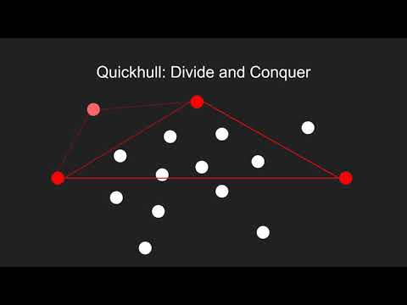
Quick Convex hull Algorithm
Youtube : CompSciGuy

Slide 10

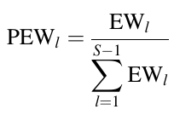
Functional Evenness
Functional evenness describes the evenness of abundance distribution in a functional trait space.
Minimum Spanning Tree : Tree that links all the points contained in a T-dimensional space with the minimum sum of branch lengths.
where EW is weighted evenness, dist(i, j ) is the Euclidean distance between species i and j, the species involved is branch l, and wi is the relative abundance of species i.
compute the MST in the ‘‘ape’’ R-package, which returns
the S - 1 branches between the S species.
Then we calculate the partial weighted evenness (PEW) as; Villeger et al. 2008

Slide 11
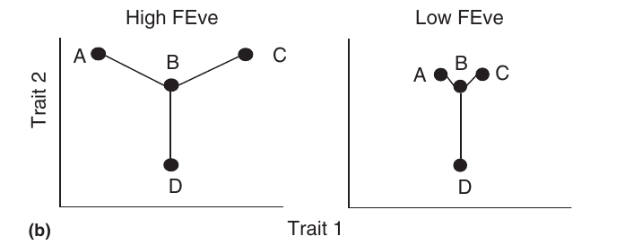
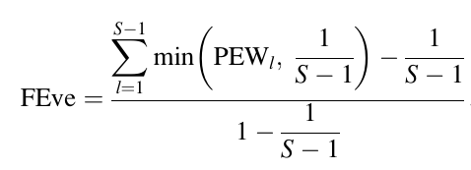
Functional Evenness
Functional evenness describes the evenness of abundance distribution in a functional trait space.
Villeger et al. 2008

Slide 12
Mason et al 2013
The perfectly even abundances and the identical distances between nearest neighbor species in two dimensional trait space (as defined by the minimum spanning tree) would yield an FEve value of 1.
The low FEve example would yield a decreased value due to the variability in nearest neighbor distances

Slide 13
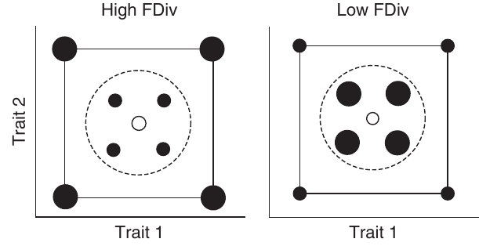
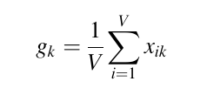
Functional Divergence
FDiv measures the degree to which the abundance of a
community is distributed toward the extremities of occupied
functional trait space.
first find the convex hull for the species present.
then finds the coordinates of the center of gravity for the convex hull.
Finally, it applies a series of equations to compare the observed sum of abundance-weighted Euclidean distances of species from the center of gravity relative to the maximum possible value.
Mason et al 2013

Slide 14
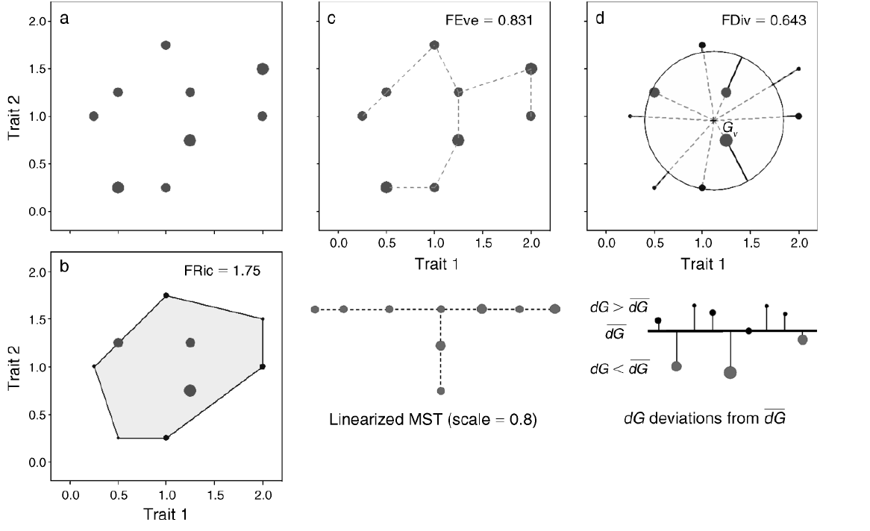
Circles represent species, and diameters are species relative abundances
Villeger et al. 2008

Slide 15
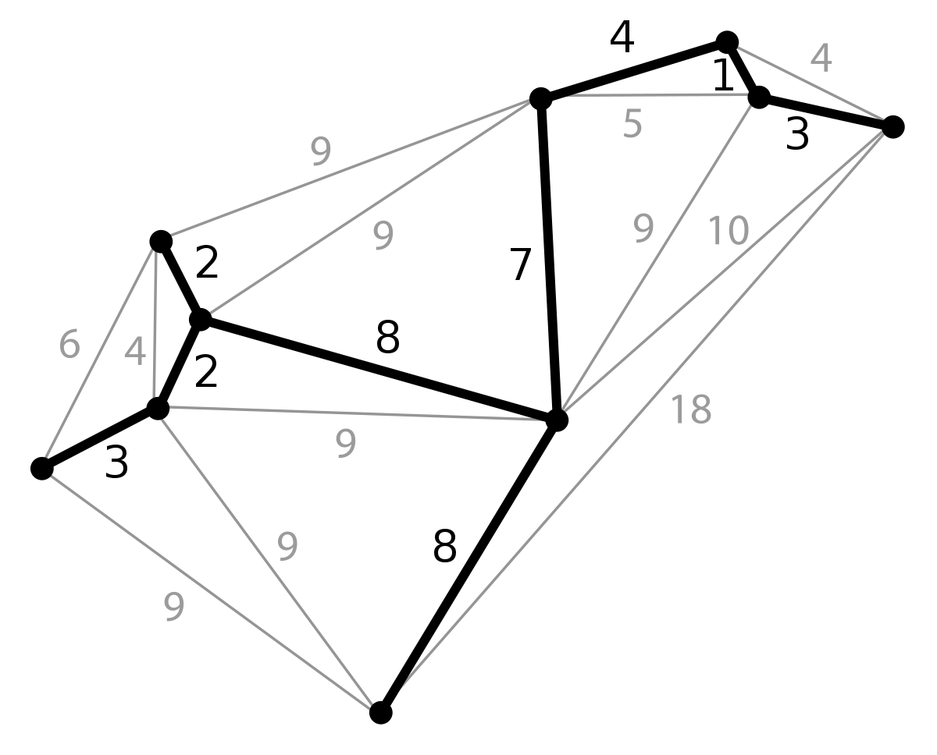

Slide 16
Twinning Criterion: Diversity is not affected when a species is replaced by two species with the same trait values and the same total abundance.
FRic can satisfy
FDiv can satisfy
But FEven cannot.

Slide 17
Monotonicity criterion :
A subset of a community is less diverse that this community.
The functional-richness value of a subset of species cannot be superior to the functional richness value of the whole set. Functional divergence and functional evenness do not match this criterion.

Slide 18
Concavity criterion :
A set of communities is in mean less diverse than the aggregated pool.
Functional richness is the only index to respect the concavity criterion, for the same reason as for the monotonicity criterion

Slide 19

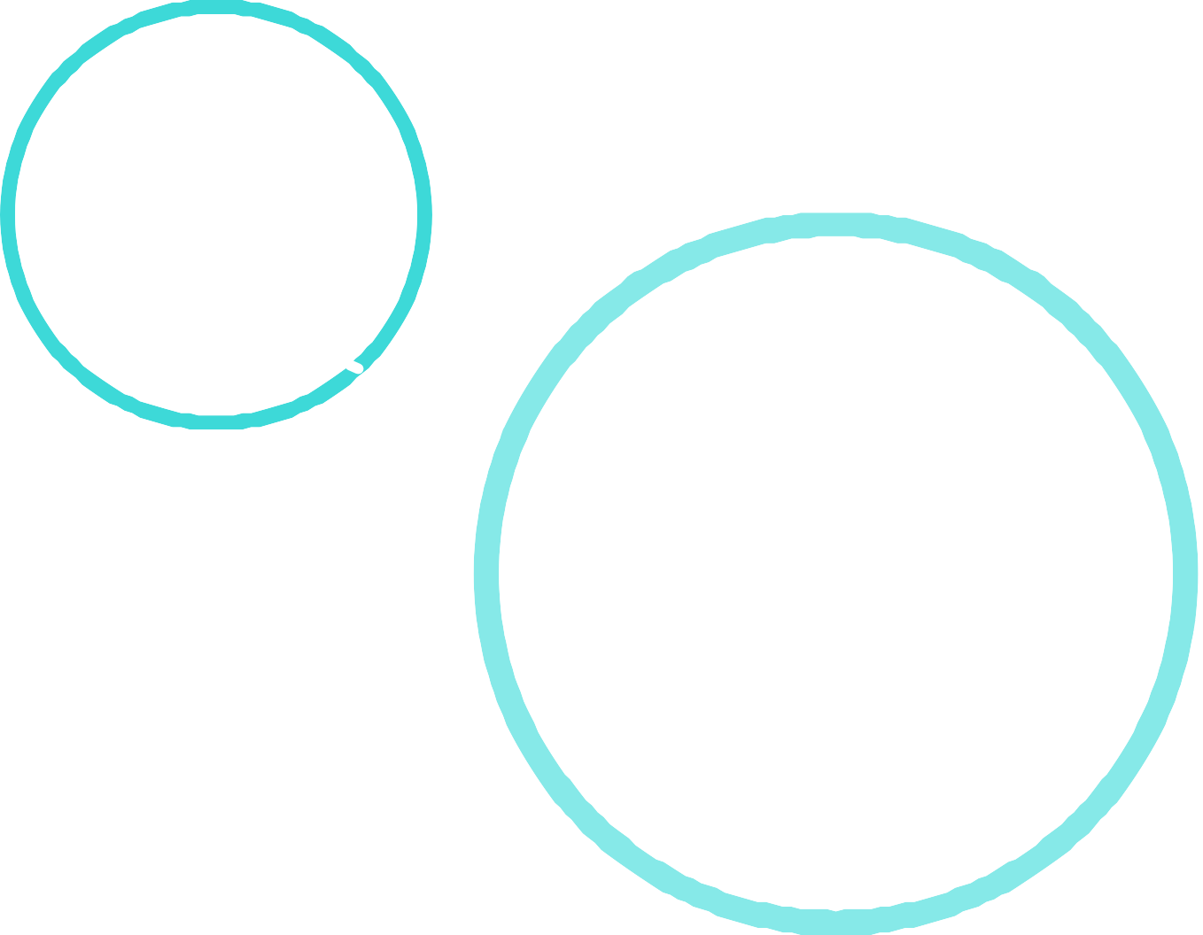

Not independent of species richness
Satisfy Twinning
criterion
Functional Richness
Satisfy Concavity
criterion
Satisfy Monotonicity criterion
Independent of species richness
MULTIDIMENSIONAL FUNCTIONAL DIVERSITY INDICES
Functional Evenness
Cannot satisfy Twinning
criterion
Cannot satisfy Concavity
criterion
Independent of species richness
Cannot Satisfy Monotonicity criterion
Satisfy Twinning
criterion
Functional Divergence
Cannot satisfy Concavity
criterion
Cannot Satisfy Monotonicity criterion

Slide 20
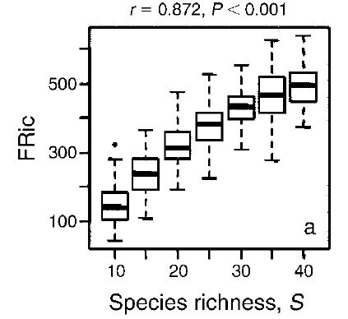
Villeger et al. 2008
Go to the paper

Slide 21
Questions:
Why is it important to establish functional divergence and functional evenness are independent of species richness ? and three indices are independent of each other.
If species are in terminal points in the MST then the terminal points are accounted only once while the intermediate points are accounted twice in FEve Calculation
Need of Center of Gravity while there is already centroid of convex hull?

Slide 22
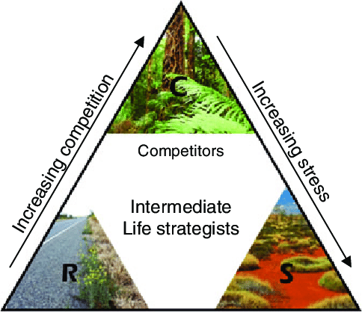

Slide 23
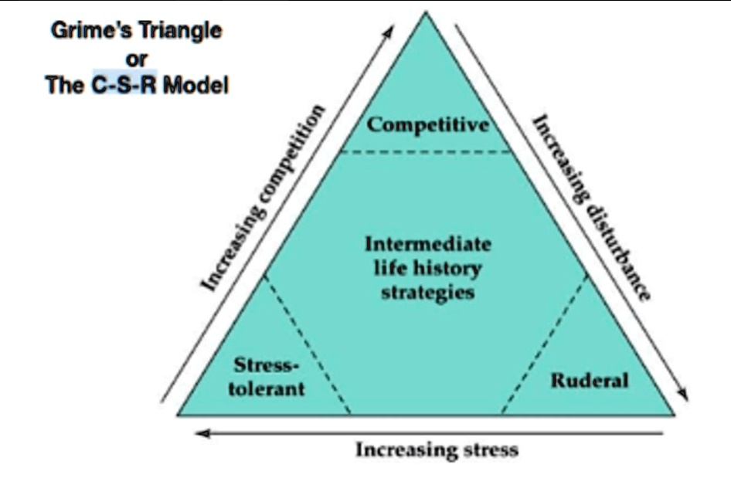

Slide 24
Functional Diversity
Functional diversity refers to those components of biodiversity that influence how an ecosystem operates or functions
The biological diversity, or biodiversity, of a habitat is much broader and includes all the species living in a site, all of the genotypic and phenotypic variation within each species, and all the spatial and temporal variability in the communities and ecosystems that these species form.
Functional diversity, which is a subset of this, is measured by the values and range in the values, for the species present in an ecosystem, of those organismal traits that influence one or more aspects of the functioning of an ecosystem.
Functional diversity is of ecological importance because it, by definition, is the component of diversity that influences ecosystem dynamics, stability, productivity, nutrient balance, and other aspects of ecosystem functioning.
David Tlimann2001

Slide 25
Difference between PCoA and PCA
PCA focuses on shared variance: it tries to summarize multiple variables in the minimum number of components so that each component explains the most variance. PCoA on the other hand focuses on distances, and it tries to extract the dimensions that account for the maximum distances

Slide 26
Timeline
Blue is the colour of the clear sky and the deep sea
Red is the colour of danger and courage
Black is the color of ebony and of outer space
Yellow is the color of gold, butter and ripe lemons
White is the color of milk and fresh snow
Blue is the colour of the clear sky and the deep sea
JAN
FEB
MAR
APR
MAY
JUN
JUL
AUG
SEP
OCT
NOV
DEC
Yellow is the color of gold, butter and ripe lemons
White is the color of milk and fresh snow
Blue is the colour of the clear sky and the deep sea
Red is the colour of danger and courage
Black is the color of ebony and of outer space
Yellow is the color of gold, butter and ripe lemons

Slide 27
Roadmap
Blue is the colour of the clear sky and the deep sea
Red is the colour of danger and courage
Black is the color of ebony and of outer space
1
3
5
2
4
6
Yellow is the color of gold, butter and ripe lemons
White is the color of milk and fresh snow
Blue is the colour of the clear sky and the deep sea

Slide 28
Gantt chart
 | Week 1 |  |  |  |  |  |  | Week 2
 | 1 | 2 | 3 | 4 | 5 | 6 | 7 | 8 | 9 | 10 | 11 | 12 | 13 | 14
Task 1
Task 2 |  |  |  |  |  | ◆
Task 3
Task 4 |  |  |  |  |  |  |  |  |  |  | ◆
Task 5 |  |  |  |  |  |  |  |  | ◆
Task 6
Task 7
Task 8

